Slide 1
LALP SET 5
Dr. Pradeep .J.Jha

Slide 2
LALP 5.1
Linear Programming: (L.P.)
When the resources like money, manpower, material, and time are to be allocated to different types of activities on certain given constraints wth an objective like maximizing the profit or minimizing the loss, we have problems
. Activities consume resources which are given to perform activities like production, sale, marketing, and parallel work like these but all these have an objective. Objectives may be like profit / production maximization or may be of cost minimization.
Conditions imposed on execution of activities on consumption of resources are called constraints.
In this way, the number of units of the activities of each type will be called Decision variable.

Slide 3
LALP 5.2
In most of the cases the decision variables are required to be non-negative.
All the decision variables, wherever they appear ( in objective function or in the constraints) are always linear.
Programming does not mean computer programming but it means ‘planning ‘. Planning of allocation of resources in to the different activities with specific objective.

Slide 4
LALP 5.3
A designer plans to share two departments A and B available for 160 and 180 hours respectively. He thinks of manufacturing tables and chairs which will be sold in the market with a profit of 10 rs. and 15 rs. Respectively. One table takes 4 hours in dept. A and the chair takes 2 hours in dept. B. A chair takes 3 hours in dept. A and 6 hours in dept. B. Deprtment A and B are available for 160 and 180 hours respectively. Design allocations so tht he gets maximum profit.
Resources: Dept A: 160 hours and dept. B : 180 hours.
Activities : Tables Chairs
Dept A Dept. B profit per unit
Table: 4 2 rs. 10
Chair 2 6 rs. 15

Slide 5
LALP 5.4
Resources: Dept A: 160 hours and dept. B : 180 hours.
Activities : Tables Chairs
Dept A Dept. B profit per unit Plan
Table: 4 2 rs. 10 x units
Chair 2 6 rs. 15 y units
Find x and y so that F(x,y) = 10 x + 15 y is maximized
With constraint on resources (1) 4x + 2y ≤ 160 , (2) 2x + 6y ≤ 180
Non negativity constraints (2) x , y ≥ 0

Slide 6
LALP 5.5
General (LPP)Model:
Find x₁ , x2,……,xn ( Decision variables)
In order to optimize z = c1x1 + c2x2 + c3x3 + …………………+ cnxn (1)
Subject to a11 x1 + a12 x2 + ………………………..+ a1n xn ≤, =, ≥ b1
a21 x1 + a22 x2 + ………………………..+ a2n xn ≤ ,= , ≥ b2
am1 x1 + am2 x2 + ………………………..+ amn xn ≤ = ≥ b_{m}
( Where in each each constraint one and only one sign holds true)
With all xi ≥ 0 [ There are n D.V. and m constraints, m ≤ n]
All ci ≥ 0 are cost / profit factors. All bi ≥ 0 are the resources
A = (a_{ij}) is a mxn matrix.

Slide 7
LALP 5.6
Ex. 2 Planning a menu. Type P and Type Q.
fat Carbohydrate Protein ( content in 10 gram) cost/10gram
Type P. 2 3 5 10
Type Q 3 4 2 20
Requirement 20 24 16
(minimum)
Let x1 and x2 be amount of type p and type q of the food to be planned to satisfy the requirement and minimize the cost.
Construct the model. Find x1 and x2 so as to minimize the total purchase cost: 10 x1 + 20 x2 subject to 2x1 + 3x2 ≥ 20 fat const.
3x1 + 4x2 ≥ 24, 5x1 + 2x2 ≥ 16,
With x1, x2 ≥ 0

Slide 8
LALP 5.7
Ex-3 investment of 200,000 in two types of bonds aa and bb.
aa pays 7% and bb pays 9 % interest. Not more than 60.000 to be invested in bb. The amount invested in aa must be at least twice of the one invested in bb. Find the solution .
Say x rs. In aa type and y rs. In bb type.
To maximize : 0.07 x + 0.09 y interest from both aa and bb
x + y = 200000
y ≤ 60000
x ≥ 2y
with x, y ≥ 0

Slide 9
LALP 5.5
General (LPP)Model:
Find x₁ , x2,……,xn ( Decision variables)
In order to optimize z = c1x1 + c2x2 + c3x3 + …………………+ cnxn (1)
Subject to a11 x1 + a12 x2 + ………………………..+ a1n xn ≤, =, ≥ b1
a21 x1 + a22 x2 + ………………………..+ a2n xn ≤ ,= , ≥ b2
am1 x1 + am2 x2 + ………………………..+ amn xn ≤ = ≥ b_{m}
( Where in each each constraint one and only one sign holds true)
With all xi ≥ 0 [ There are n D.V. and m constraints, m ≤ n]
All ci ≥ 0 are cost / profit factors. All bi ≥ 0 are the resources
A = (a_{ij}) is a mxn matrix.

Slide 10
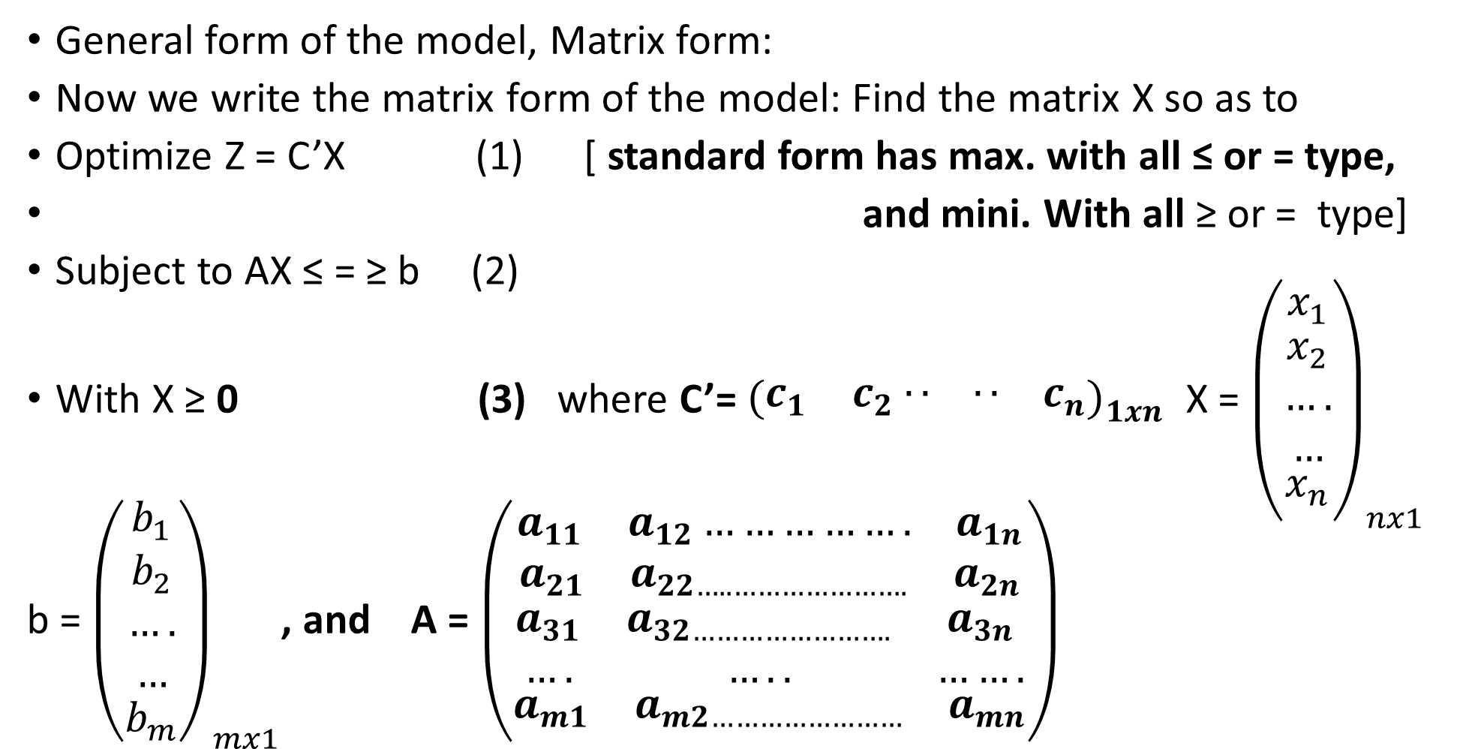
LALP 5.8
General form of the model, Matrix form:
Now we write the matrix form of the model: Find the matrix X so as to
Optimize Z = C’X (1) [ standard form has max. with all ≤ or = type,
and mini. With all ≥ or = type]
Subject to AX ≤ = ≥ b (2)
With X ≥ 0 (3) where C’= ${\left(\begin{matrix}c_{1} & c_{2} \begin{matrix}.. & ..\end{matrix} & c_{n}\end{matrix}\right)}_{1xn}$ X = ${\left(\begin{matrix}x_{1} \\ \begin{aligned}x_{2} \\ …. \\ …\end{aligned} \\ x_{n}\end{matrix}\right)}_{nx1}$
b = ${\left(\begin{matrix}b_{1} \\ \begin{aligned}b_{2} \\ …. \\ …\end{aligned} \\ b_{m}\end{matrix}\right)}_{mx1}$, and A = $\left(\begin{aligned}\begin{matrix}a_{11} & a_{12}……………. & a_{1n}\end{matrix} \\ \begin{matrix}a_{21} & a_{22…..………………….} & a_{2n}\end{matrix} \\ \begin{matrix}a_{31} & a_{32…………………….} & a_{3n} \\ …. & ….. & …….\end{matrix} \\ \begin{matrix}a_{m1} & a_{m2……………………} & a_{mn}\end{matrix}\end{aligned}\right)$

Slide 11
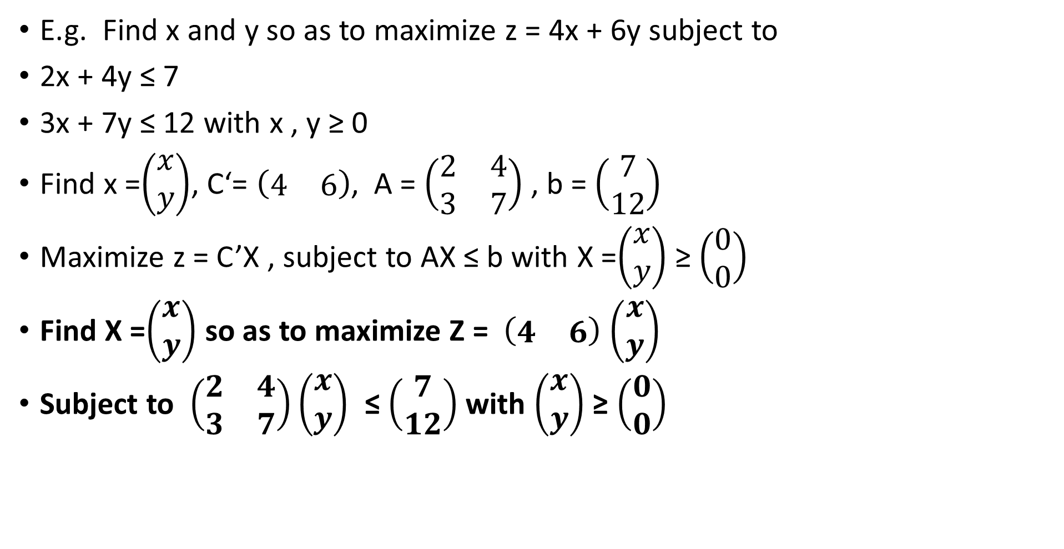
LALP 5.9
E.g. Find x and y so as to maximize z = 4x + 6y subject to
2x + 4y ≤ 7
3x + 7y ≤ 12 with x , y ≥ 0
Find x =$\left(\begin{matrix}x \\ y\end{matrix}\right)$, C‘= $\left(\begin{matrix}4 & 6\end{matrix}\right)$, A = $\left(\begin{matrix}2 & 4 \\ 3 & 7\end{matrix}\right)$ , b = $\left(\begin{matrix}7 \\ 12\end{matrix}\right)$
Maximize z = C’X , subject to AX ≤ b with X =$\left(\begin{matrix}x \\ y\end{matrix}\right)$ ≥ $\left(\begin{matrix}0 \\ 0\end{matrix}\right)$
Find X =$\left(\begin{matrix}x \\ y\end{matrix}\right)$ so as to maximize Z = $\left(\begin{matrix}4 & 6\end{matrix}\right)$ $\left(\begin{matrix}x \\ y\end{matrix}\right)$
Subject to $\left(\begin{matrix}2 & 4 \\ 3 & 7\end{matrix}\right)\left(\begin{matrix}x \\ y\end{matrix}\right)$ ≤ $\left(\begin{matrix}7 \\ 12\end{matrix}\right)$ with $\left(\begin{matrix}x \\ y\end{matrix}\right)$ ≥ $\left(\begin{matrix}0 \\ 0\end{matrix}\right)$

Slide 12
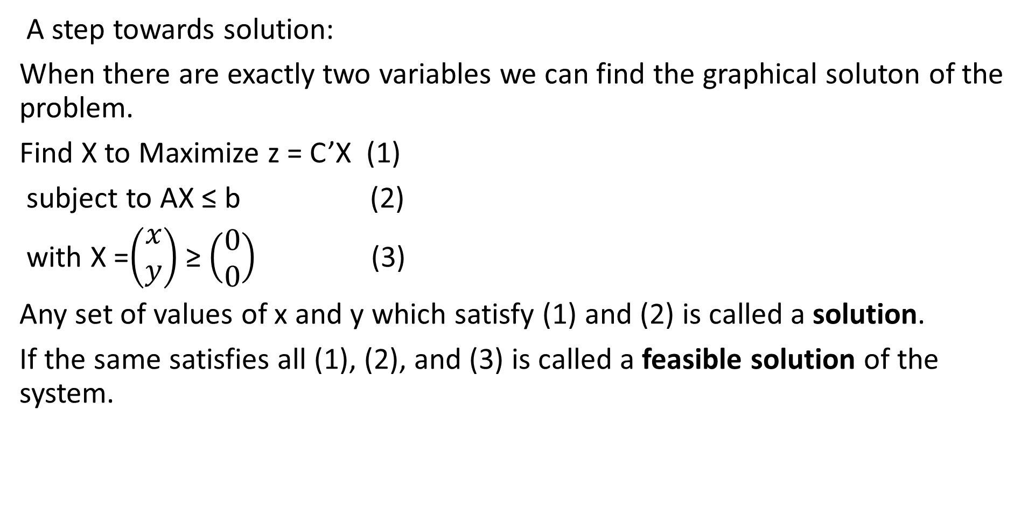
LALP 5.10
A step towards solution:
When there are exactly two variables we can find the graphical soluton of the problem.
Find X to Maximize z = C’X (1)
subject to AX ≤ b (2)
with X =$\left(\begin{matrix}x \\ y\end{matrix}\right)$ ≥ $\left(\begin{matrix}0 \\ 0\end{matrix}\right)$ (3)
Any set of values of x and y which satisfy (1) and (2) is called a solution.
If the same satisfies all (1), (2), and (3) is called a feasible solution of the system.

Slide 13
LALP 5.11
Graphical Solution:
1 When there are exactly two variables one can use graphical solution.
2 Consider inequality of the constraint as equality. Each equality is now an equation of a line. Ax + by + c = 0
3 Considering the last non-negativity constraint we shall find our feasible solution in first quadrant only.
4 Draw each constraint line and find region corresponding to inequality.
5 Do the same for all constraints.
6 Find the most common region to all inequality constraints.
7 If the common region is a convex polygon or an open region bounded below then only the optimal solution exists.

Slide 14
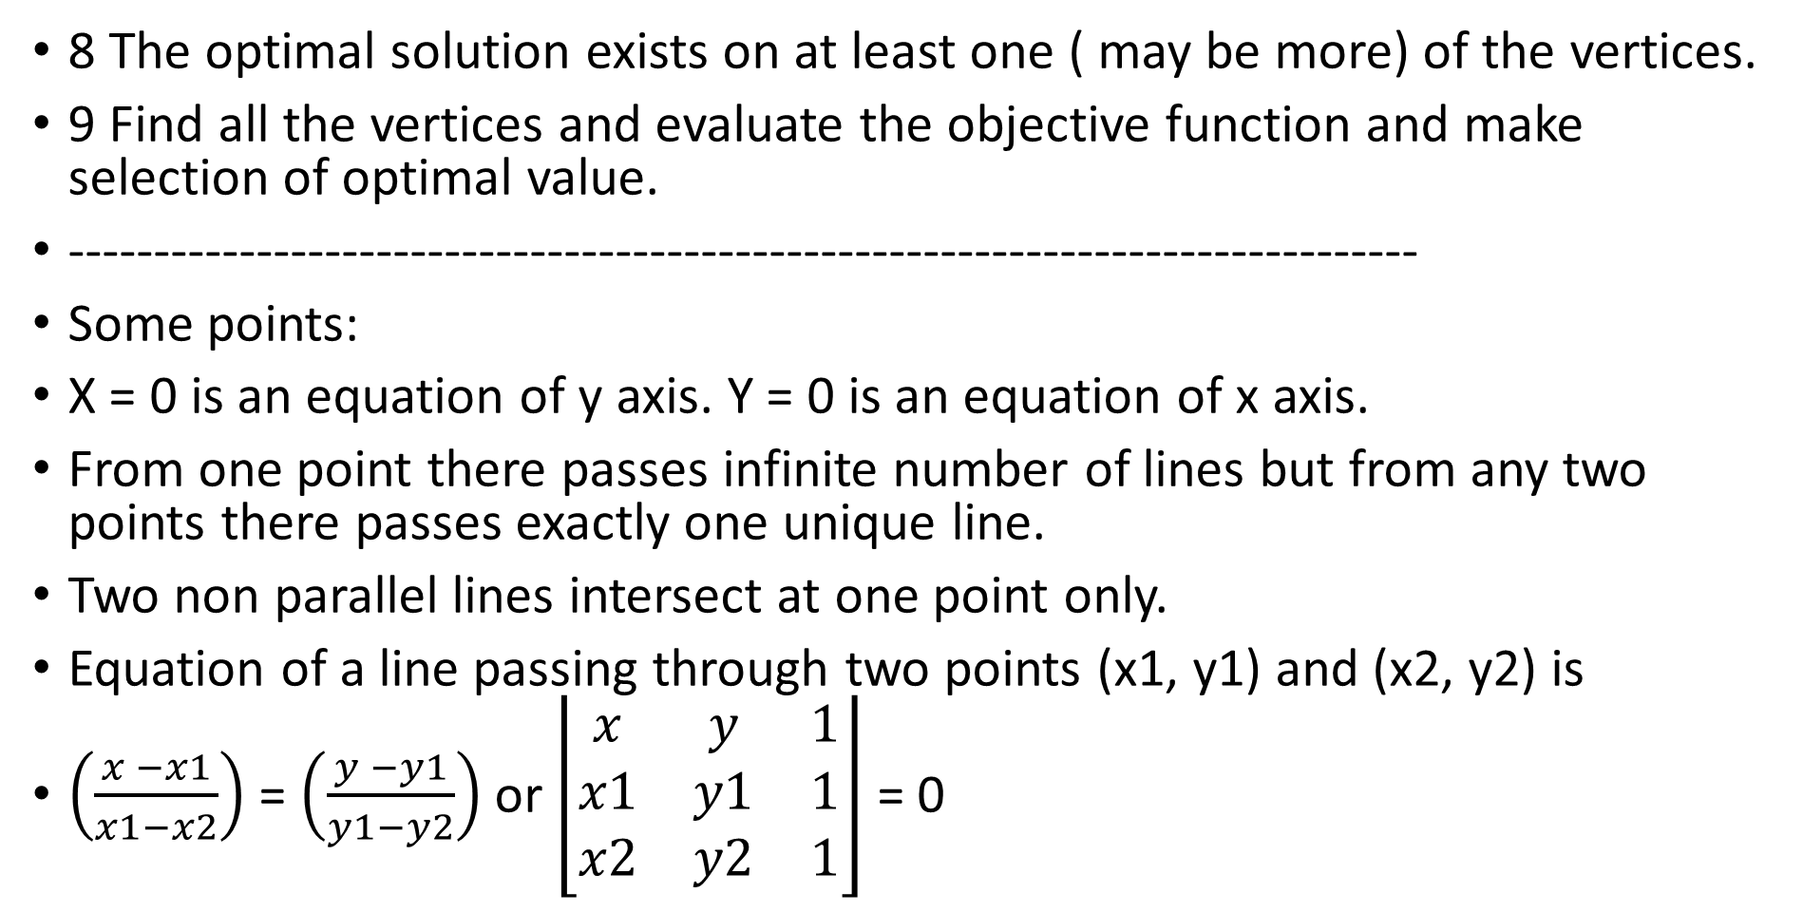
LALP 5.13
8 The optimal solution exists on at least one ( may be more) of the vertices.
9 Find all the vertices and evaluate the objective function and make selection of optimal value.
-------------------------------------------------------------------------------
Some points:
X = 0 is an equation of y axis. Y = 0 is an equation of x axis.
From one point there passes infinite number of lines but from any two points there passes exactly one unique line.
Two non parallel lines intersect at one point only.
Equation of a line passing through two points (x1, y1) and (x2, y2) is
$\left(\frac{x −x1}{x1−x2}\right)$ = $\left(\frac{y −y1}{y1−y2}\right)$ or $\left\lfloor \begin{matrix}x & y & 1 \\ x1 & y1 & 1 \\ x2 & y2 & 1\end{matrix}\right\rfloor$ = 0

Slide 15
LALP 5.14
Two intercept Form: y x =2
X = constant is a line parallel to y axis. Y = 1
Y = constant is a line parallel to x axis. 0 x
If ‘a’ and ‘b’ are the intercepts on x and y axis then intercept form of the line
x/a + y/b = 1 where a and b are intercepts other than zero. 2x + 4y = 8
, x/4 + y/2 =1
General equation of a line is ax + by +c = 0
Find the equation of line passing through (1 , 3) and ( -2, 4),
(x- 1)/ (1- (-2)) = (y-(3)/ ( 3- 4)
Find the intercepts of 4x + 3y = 8 4x/ 8 + 3y /8 = 1, x/2 + y/ (8/3) = 1

Slide 16
LALP 5.15
Y Find x and y so as to maximize z = 5x +7y
subject to x + y ≤ 4 (1), 3x + 8y ≤ 24 (2) with x, y ≥ 0
Solution: Consider x +y = 4 (1) for y = 0, x = 4 Point (4,0)
B(0,4) Region for x = 0, y = 4 Point (0,4)
The regon OAB is the required region ≤
0 A(4,0) x Consider 3x + 8y = 24 (1) for y = 0 , x = 8, point (8,0)
(2) for x = 0, y = 3 , Point (0,3)
Y Y
B
C(0,3) Region ODC C P The most common region is OAPC
0 D(8,0) x O A D x O(0,0), A(4,0), P(8/5,12/5),
C(0,3)

Slide 18
LALP 5.16
Example: Resources: Dept A: 160 hours and dept. B : 180 hours.
Activities : Tables Chairs
Dept A Dept. B profit per unit Plan
Table: 4 2 rs. 10 x units
Chair 2 6 rs. 15 y units
Find x and y so that F(x,y) = 10 x + 15 y is maximized
With constraint on resources (1) 4x + 2y ≤ 160 , (2) 2x + 6y ≤ 180
Non negativity constraints (2) x , y ≥ 0

Slide 19
LALP 5.17
1 Consider 4x + 2y ≤ 160 , for y = 0 , x =40 , Point A ( 40,0,)
for x = 0,y = 80 point B (0 , 80)
2x + 6y ≤ 180 for y =0, x= 90, point C (90, 0 ) for x = 0, y = 30 ,Point D(0,30 )
y
B(0,80)The most common region to OAB and CDO is APDO. This is a convex
polygon and hence solution lies on at least one of the vertex.
D P A(40,0), P ( , ) , D(0,30) and O(0,0), Evaluate objective . Function on vertices.
Points Value of 10x + 15 y
O A(40,0) C(90,0) x A ( 40,0) 10(40) + 15(0) = 400
P(30,20) 10(30) + 15(20) =600 so x =30, y = 20
D(0,30) 0(10) + 15(30) = 450

Slide 20
LALP 5.18
Let x1 and x2 be amount of type p and type q of the food to be planned to satisfy the requirement and minimize the cost.
Construct the model. Find x1 and x2 so as to minimize the total purchase cost: 10 x1 + 20 x2 subject to 2x1 + 5x2 ≥ 20 fat const.(2x + 5y = 20)
Y 3x1 + 4x2 ≥ 24 [ 3x + 4y =24] 5x1 + 2x2 ≥ 16, With x1, x2 ≥ 0
f(0,8) The region is an open ended and bounded below. It is XAPQEY
D (0,6) Coordinates of A (10, 5) , P(40/7, 12/7) And Q(8/7, 36/7) and E(0,8) Now evaluate objective f . Q
B(0,4) Point value of obj. fun= 10x1 + 20x2
A(10,5) 100+100 = 200
P P (40/7 , 12/7) 400/7 + 240/7 = 640/7 = 91
O E(3.4,0) C(8,0) A(10,0) X Q (8/7, 36/7) 80/7 + 720/7 = 800/7 = 114

Slide 21
LALP 5.19
Going to Simplex: In the case of linear programming problems in two variables, possibly we can find graphical solution to a given problem with finite number of constraints. The case in which the number of decision variables exceed two or many constraints of different types then the graphical method is not applicable and we have Simplex method with us. There are certain conditions before a problem can be solved using Simplex method.
1 Converting inequality constraints in to equality:
(a) Slack variable: If the given constraint is of the ≤ type then we follow this routine.
Let a11 x1 + a12 x2 + ……….+ a1n xn ≤ b1 be a constraint. We know that the quantity on the right side shows resource. The expression on the left shows actual usage of the resource.

Slide 22
LALP 5.20
E.g. say 2x + 3y ≤ 20 x = number of tables and y = number of chairs to be manufactured. 20 is the amount of wood given.
2x + 3y = actual use of wood in making x number of tables and y number of chairs. [consumption can be at the most 20 units. If all units used thn fine if some amount of wood remains unused than it is not going to add in the total profit. The unutilized resource [ leftover resource] is called slack variable.Let us denote it by s1. [ the first slack variable]
We have 2x + 3y + s1 = 20. S1 is a slack variable.
Contribution of slack variable to the objective function is zero.
2 SURPLUS VARIBLE: Consider inequality of the type ≥.
say 2x + 5y ≥ 8. Right sideis the resource and the left side is the actual usage. The usage in this case is greater then the resource. To make equality we subtract a variable say s2 from left side. 2x + 5y - S2 = 8. This variable S2 is called a surplus variable.
Contribution of surplus variable to the objective function is zero.
≤

Slide 23
LALP 5.21
After converting inequality in to equality the next step is to have a basic variable in each equality constraint.
A basic variable is that which appears with its coefficient +1 in each equation. [ In remaining equation its coeff. Is zero.]
2x + 3y ≤ 8 constraint with introduction of slack variable becomes
2x + 3y + 1S1 = 8. In this case coeff. Of S1 is +1. This slack variable can be called a basic variable.
2x + 3y ≥ 8 becomes, on introduction of surplus variable becomes
2x + 3y – 1s = 8. This surplus variable has coeff. = -1. It cannot be treated as a basic variable. [Why ?]
3x + 4y = 9 has no basic variable.

Slide 24
LALP 5.23
Find x and y to maximize,
Z = 6x +9y
Subject to 6x + 8y ≤ 20 6x + 8y +1s1 = 20 6x + 8y +1s1 =20
4x + 7y ≥ 25 4x + 7y -1s2 = 25 4x + 7y -1s2 + 1A1 =25
9x + 6y = 50 9x + 6y = 50 9x + 6y + 1A2 =50
x, y ≥ 0 x, y , s1, s2, A1, A2 ≥ 0
Maximize,z = 6x + 9y +0s1 +0s2 – MA1 –MA2
6x + 8y +1s1 +0s2 +0A1 +0A2 =20
4x + 7y +0s1 -1s2 + 1A1 +0A2 =25
9x + 6y +0s1 +0s2 +0A1+ 1A2 =50 , x, y , s1, s2, A1, A2 ≥ 0

Slide 25
LALP 5.24
Problem1: D(0,6)
Find x and y to maximize z =5x + 6y
S.t. x + y ≤ 4, 2x + y ≤ 6, x,y ≥ 0 B(0,4) P(2,2)
Consider x + y = 4, and 2x + y = 6 0 C(3,0) A(4,0)
Draw lines and regions.
Most common region to both constraint is OCPB. Solve the equations of lines. Get the point P (2 ,2 ).
Point Value of 5x + 6y
O(0 , 0) 5(0)+ 6(0) = 0
C( 3,0) 5(3) + 6(0) =15
P(2 , 2 ) 5(2) + 6(2) =22 Max. occurs at x = 0, y = 4, Max. Profit = 24
B (0 ,4 ) 5(0) +6(4) =24

Slide 26
LALP 5.25
Solving with Simplex.
Find x and y to maximize z =5x + 6y
S.t. x + y ≤ 4, 2x + y ≤ 6, y ≤ 3 x,y ≥ 0
1 Make equality. 2 A basic variable in each 3 Rhs > 0
Restructure the problem.
problem 2 Find x and y to maximize z =5x + 6y
S.t. x + y ≤ 4, 2x + y ≤ 6, y ≤ 3, x, y ≥ 0
D
B
o c A

Slide 27
LALP 5.26
Find x and y to maximize z = 5x +8y is an objective fun.
Subject to 1x + 5y ≤ 11, 2x + 8y ≤ 12 x, y ≥ 0
-------------------------------------------------------------
Max. 5x + 8y + 0s1 +0s2
1x + 5y + 1s1 + 0s2 = 11
2x + 8y + 0s1 + 1s2 = 12, x, y ,s1, s2 ≥ 0 s1 and s2 are slack.

Slide 28
Cj 5 8 0 0
VAR x y s1 s2 Rhs R.R.
Basis
0 s1 1 5 1 0 11
0 s2 2 8 0 1 12
cj-zj Find x and y to minimize
z = 4x -1y
s.t. 3x + 5y ≤ 20
x + 4y ≤ 5
2x ≤ 8, x, y ≥ 0

Slide 29
Min.

Slide 30
Cj 4 -1 0 0 0
VAR x y s1 s2 s3 Rhs R.R.
Basis
0 s1 3 5 1 0 0 20
0 s2 1 4 0 1 0 5
0 s3 2 0 0 0 1 8
z = 4x -1y
s.t. 3x + 5y ≤ 20
x + 4y ≤ 5
2x ≤ 8, x, y ≥ 0

